Slide 1
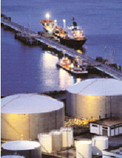
Rosemount Tank Radar

Slide 2
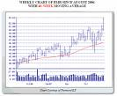
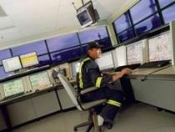
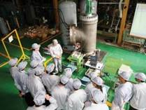
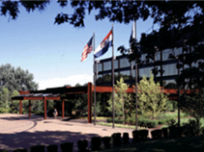
Emerson At-a-Glance
$21.0 Billion in sales (2010)
NYSE: EMR
Diversified global manufacturer and technology provider
Approximately 127,700 employees worldwide
Headquarters in St. Louis, Mo.
Manufacturing and/or sales presence in more than 150 countries
240 manufacturing locations worldwide and 127,700 employees
No. 117 on 2010 FORTUNE 500 list of America’s largest corporations
Founded in 1890
Notes:
2

Slide 3
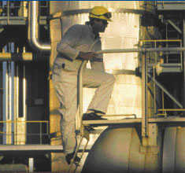
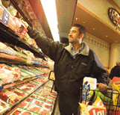


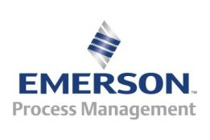



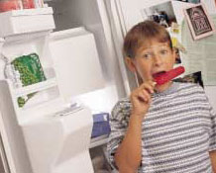
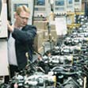
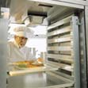
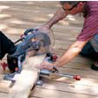




Emerson. Creating Technology and Solutions for a World in Action

Slide 4
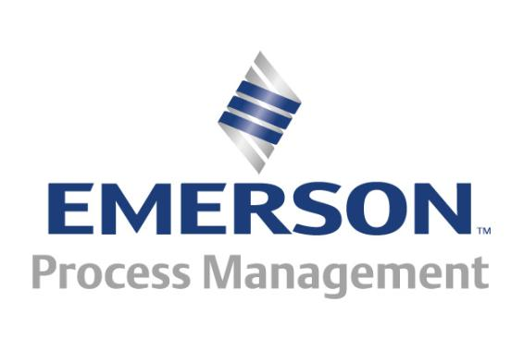
Emerson Process Management
Emerson Process Management is the largest Emerson business segment and represents 28% of the total Emerson business.
Industrial Automation
Climate Technologies
Network Power
Motor Technologies
Appliance Solutions
Professional Tools
Storage Solutions

Slide 5
Emerson Process Management: 2010 At-a-Glance
2010
2010 Sales by Product
Sales $6.0B
Employees ~26K
Systems, Solutions & Services
Measurement Devices
24%
Global Manufacturing Facilities
45%
31%
US & Canada | 20
Europe | 20
Asia | 15
Rest of World | 5
Total | 60
Valves &
Regulators
2010 Sales by Geography
Major Customers:
Bayer, BP, CNPC, ConocoPhillips, ExxonMobil, Fluor, General Electric, PDVSA, Pemex, Petrobas, Qatargas, Saudi Aramco, Shell, Sinopec, Suncor Energy, Total SA
Latin America
Middle East & Africa
7%
10%
37%
North America
23%
23%
Europe
Asia Pacific
Notes:
5
5
5

Slide 6


Emerson Organization Overview
Emerson
Process Management
Climate Technologies
Rosemount Inc.
Network Power
Industrial Automation
Rosemount Tank Radar
Motor Technologies
Storage Solutions
Rosemount Tank Radar is the Emerson
Radar Center of Excellence
Professional Tools
Appliance Solutions
Appliance & Tools

Slide 7
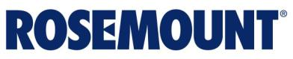
Headquartered in Chanhassen, Minnesota
1.4 BUSD sales worldwide in 2010
About 6,500 employees worldwide / 1,600 in the Twin Cities
World leader in Pressure, Temperature, and Level Instrumentation for the process control and marine industries
Pressure transmitters twice named as one of the “100 Best products made in America”

Slide 8
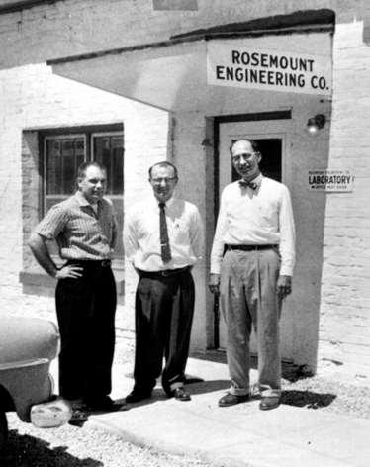
Rosemount History
1956 - Rosemount Engineering Co. founded
1950s and 1960s - Manufactured temperature sensors for jet aircraft and Apollo space missions
1960s and 1970s - Aeronautical technology applied to industrial products
1976 - Acquired by Emerson
2001 - Acquired Rosemount Tank Radar (formerly Saab Marine Electronics)
2005 - Acquired Mobrey
2007 - Acquired Damcos
Other smaller acquisitions over time
Notes:
Frank Werner, Vern Heath, and Robert Keppel established Rosemount Engineering Company with $8000 of startup funds.
Government needed air speed sensor for aircraft. And asked U of M to develop. They liked the product and wanted to order more which wasn’t possible. These three went off to start their own company in a chicken coupe.
1960… Rosemount sensors on every aircraft in the world.

Slide 9

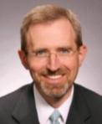
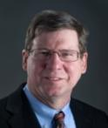
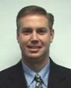
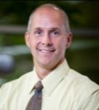
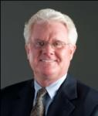
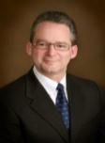

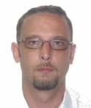

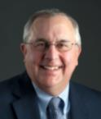
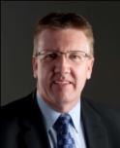
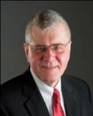
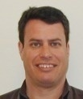

Rosemount’s Strategic Leadership Team
Tom Moser
President
Jon Stokes
President
Level/Marine
Mark Schumacher
President
Worldwide Pressure
Nick Grant
VP & GM
Worldwide Temperature
Bob Karschnia
Vice President
Wireless
John Turner
Vice President
Americas
Jim Schreiner
Vice President
Europe
Phil Bond
Vice President
MEA
Shaun Taylor
Vice President
Asia Pacific
Steve Shonka
Vice President
H R & Quality
Tony Yankauskas
Vice President
Finance & CFO
Henrik Petersen
VP & GM
Marine Tank Mgmt.
Bill Rodger
Vice President
Global Operations &
Supply Chain
Tim Layer
Vice President
Quality & Customer Care
Lisa Nelson
Vice President
IT and Global Marketing

Slide 10
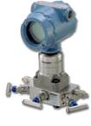
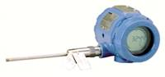
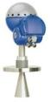
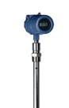
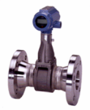
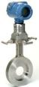
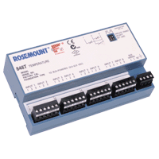
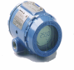
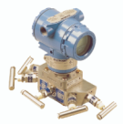
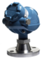
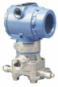
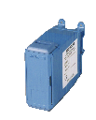
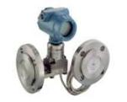
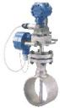
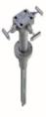
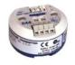
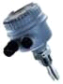
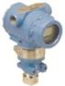
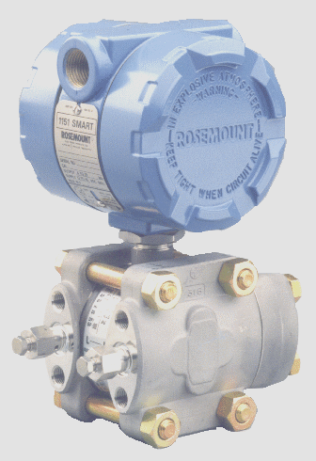
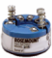
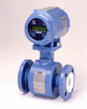
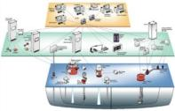
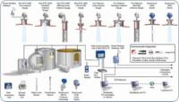



Rosemount Product Offering
Pressure
Temperature
Level
Flow

Slide 11
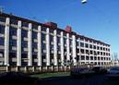
















Rosemount’s Global Facilities
Antwerp, Belgium
Naestved, Denmark
Gothenburg, Sweden
Beijing, China
Eden Prairie, USA
Karlstein, Germany
Chanhassen, USA
Slough, U.K.
Pusan, S. Korea
Wessling, Germany
Boulder, USA
Shanghai, China
Brenham, USA
Chelyabinsk,
Russia
Manila, Philippines
Daman, India
Singapore
Sorocaba, Brazil
Dubai, UAE

Slide 12

Level & Marine Within the Emerson Organization
Emerson Process Management
Other business groups and divisions below
Rosemount
Customers
Pressure
Temperature
Marine Tank
Management
Damcos
Rosemount
Tank Radar
Level & Marine group
Level
Process Level
Tank Gauging
Mobrey
Measurement
Micro Motion
Other divisions

Slide 13

Level & Marine Covers the World
MTM, Denmark (2)
VRC, Marine Systems
Level & Marine E&D, Russia
MTM, Finland
MTM & Tank Gauging Korea
VRC Manufacturing, local sales & service
Process Level & Mobrey Flow, UK
Mobrey products
Rosemount Tank Radar, Sweden
Tank Gauging Systems, Process Radar, Marine Radar Systems, LevelDatic Systems
RMD Chanhassen
Tank Gauging & MTM, Houston
Regional sales, service & distribution
MTM, China
VRC Manufacturing, local sales & service
Tank Gauging, Bahrain
Regional sales & service
Tank Gauging, India
Local sales & service
MTM, Singapore
Local sales, service & distribution
RMD Singapore
RMD = Rosemount Measurement Division

Slide 14










Rosemount Level
President
Jon Stokes
General Manager Tank Gauging
Rikard Lövdahl
Director HR
Malin Lindén
Global Director E&D
Mats Nordlund
Managing Director Mobrey
Joe Willson
Director Operations & RTR Site
Rasmus Johansson
Global Director Finance
Lars Edman
Director Process Radar
Peter Lagerlöf
Global Director Quality
Gerth Forlin
Global Director Supply Chain
Richard Ahlebrand

Slide 15








Marine Tank Management
Vice President MTM
Henrik Petersen
Manager Global Marketing
Tom B Soerensen
Director Sales & Aftermarket
Per Antonsson
Director E&D and Project Engineering
Timo van’t Hoff
Manager Quality & Environment
Kurt Noernberg
Global Operations
Paco Pumajero
CFO & Manager IT Jakob Noerr
Manager HR Peter Boeving

Slide 16









Three Primary Markets
Refineries &
Tank Terminals
Marine Applications
Refineries &
Tank Terminals
Process Industry
Level gauging on both liquid and solid materials for the process industry
Reliable and highly accurate tank gauging systems for refineries and tank terminals. Includes emulation of competitor gauges and wireless transmission of signals.
Custody transfer approved level gauging, actuation and cargo/ballast control.

Slide 17





































We provide to many leading companies

Slide 18

Rosemount Tank Radar
Headquarter in Gothenburg, Sweden, E&D offices in Linköping and Jönköping
Established in 1976
Acquired by Emerson in 2001
330 employees in Sweden, another 90 worldwide
Sales app. 1 billion SEK in 2010

Slide 19
Long term growth

Slide 20
We Have Strong Competitive Positions in All Key Areas, and Room to Grow
Tank Gauging
Process Radar
Others
29%
Emerson
36%
Vega
30%
Emerson
22%
E+H
15%
Others
26%
E+H
22%
Honeywell Enraf
20%
Total Process Level
Emerson
16%
Others
45%
E+H
14%
Vega
10%
Magnetrol
6%
Siemens Milltronics
9%

Slide 21
We Have Strong Competitive Positions in All Key Areas, and Room to Grow
Marine Tank Level
Marine Valve Remote Control

Slide 22

Origin
In 1976, Rosemount Tank Radar sprung from the Saab missile division

Slide 23











Major Product Development History
World leader in level gauging for tankers
World leader in the oil industry
LNG/LPG gauge for tanker & TankRadar Rex
1976
1984
1997
2002
Rosemount 5400
2007
Rosemount 5900
First tanker delivery – SUM21
1980
First onshore delivery - TRL
1996
TankRadar PRO
1999
TankRadar STaR & Rosemount 5600 and 3300
2004
Rosemount 5300
2010
2007 Rosemount 5300
1976 SUM21
2002 TankRadar STaR
2002 Rosemount 3300
1999 TankRadar Rex
1984 TRL
1997 TankRadar PRO
1999 LNG/LPG
2002 Rosemount 5600
2004 Rosemount 5400
2010 Rosemount 5900

Slide 24

Tank Gauging System Overview

Slide 25

Process Level System Overview

Slide 26









Marine Tank Management (MTM)
MTM-
Human
Machine
Interface
Valve Remote Control
Tank Level Gauging

Slide 27

Radar Level Gauging

Slide 28
Radar Measurement Principles
Pulse Radar
Time of Flight measurement
Nano second time differences
FMCW (Frequency Modulated Continuous Wave)
Continuous transmission
Frequency measurement
Higher accuracy
Easy to manage false echoes

Slide 29


Antenna - Mechanical Design
Rough environments but still functioning
Exposed to bitumen heated to 230°C for several months
After four months in a sulfur tank

Slide 30


TankRadar® - Accuracy Verification
Fully automated data collection and calibration functionality
Two High Accuracy Distance References using Leica Tracking Lasers as reference
Accuracy Target ±0.16 mm (± 6.3 mil) covering a range from 0 to 30 meters (0 to 98.4 feet)
Low level of radar disturbances and reflections from surrounding walls, floor and ceiling
Leica Tracking Laser

Slide 31



Shaping the Future Through Innovation
► Recognized as one of the most innovative companies in Sweden
Multiple radars integrated in one antenna
Enabling very low level measurement in marine LNG
and LPG tanks
Measuring in large still pipes

Slide 32

Business Vision & Mission
Vision Be the global leader, recognized for excellence in innovative level measurement solutions that provide high value to our customers.
Mission We provide solutions customers need to improve safety, enhance product quality, increase efficiency and reduce environmental impact.

Slide 33

Company Values
Winning Spirit
- We will be market leaders.
- Endurance - we never give up!
- We triumph together.
- We celebrate our successes.
We will lead the competition!
Boldness
- We try new ideas and challenge old paradigms.
- We translate words into action.
- Mistakes are used as learning tools.
We expect the unexpected!
Customer Orientation
- Knowledge of customer needs guides our actions.
- We focus on adding value to the customer.
- We anticipate customer’s needs.
- Whenever the customer needs us, we are there.
Life cycle profit!

Slide 34

Company Values (cont.)
Co-operation
- We communicate clearly and maintain respect for the individual.
- We fulfill our promises.
- We share our knowledge with each other.
- We fully support each other to make sure that nothing “falls between cracks”.
Excellence through diversity!
Future Orientation
- We act in a long-term and systematic way.
- We are flexible.
- We “develop” our co-workers for the future!
Growth for long-term profitability!
Cost-consciousness
- We practice strict cost containment.
- We can always afford a good investment.
- Superior return on investment.
High quality at low cost!

Slide 35

Certified Supplier
Environment
Quality
Finance
ISO 14001
ISO 17894
ISO 9001
Triple A
Q
Q
Environmental management system, Certified by
Det Norske Veritas
System Engineering Assessment Cer-tificate for program-mable electronic systems in marine applications
Quality management system, Certified by
Det Norske Veritas
For the highest credit rating in Dun & Bradstreet’s credit system

Slide 36

Rosemount Tank Radar Quality Policy
Total customer satisfaction is our primary goal.
Quality is everyone’s responsibility.
We apply continuous improvement to all that we do.

Slide 37

Environmental Policy (extract)
Rosemount Tank Radar delivers products which protect the environment by preventing overfill and pollution aboard tankers and in plants within the oil and chemical industries.
Our environmental objectives aim to:
design products for minimal environmental impact throughout the life-cycle
replace materials which cause environmental impact in our processes and installations
prevent unnecessary waste products and minimize their environmental impacts
minimize environmental impact from emissions during transportation

